Slide 1
CSP451: Cloud Computing Week 9 Azure Demo Presentation
Serverless E-Commerce API
Presented by: Amit Kumar Student ID: 153260237 Email: akumar250@myseneca.ca Date: November 2025 Course: CSP451

Slide 2
Slide -1 BUSINESS PROBLEM
TRADITIONAL E-COMMERCE CHALLENGES:
High Infrastructure Costs: $500-900/month
Complex Server Maintenance
Scaling Issues During Traffic Spikes
Long Deployment Time (Weeks/Months)
TARGET AUDIENCE:
Small & Medium E-commerce Businesses
Startups with Limited Budgets
Entrepreneurs Launching Online Stores
Companies Needing Cost-Effective Solutions

Slide 3
Slide 2 -SOLUTION OVERVIEW
AZURE SERVERLESS E-COMMERCE API
KEY COMPONENTS:
Azure Functions - 3 API Endpoints
Blob Storage - Product & Order Data
Service Bus - Order Queue Processing
Function Authentication - Secure Access
KEY FEATURES:
Complete Product Catalog Management
Automated Order Processing with Tax Calculation
Real-time Payment Confirmation
Tracking Number Generation
Secure RESTful APIs

Slide 4
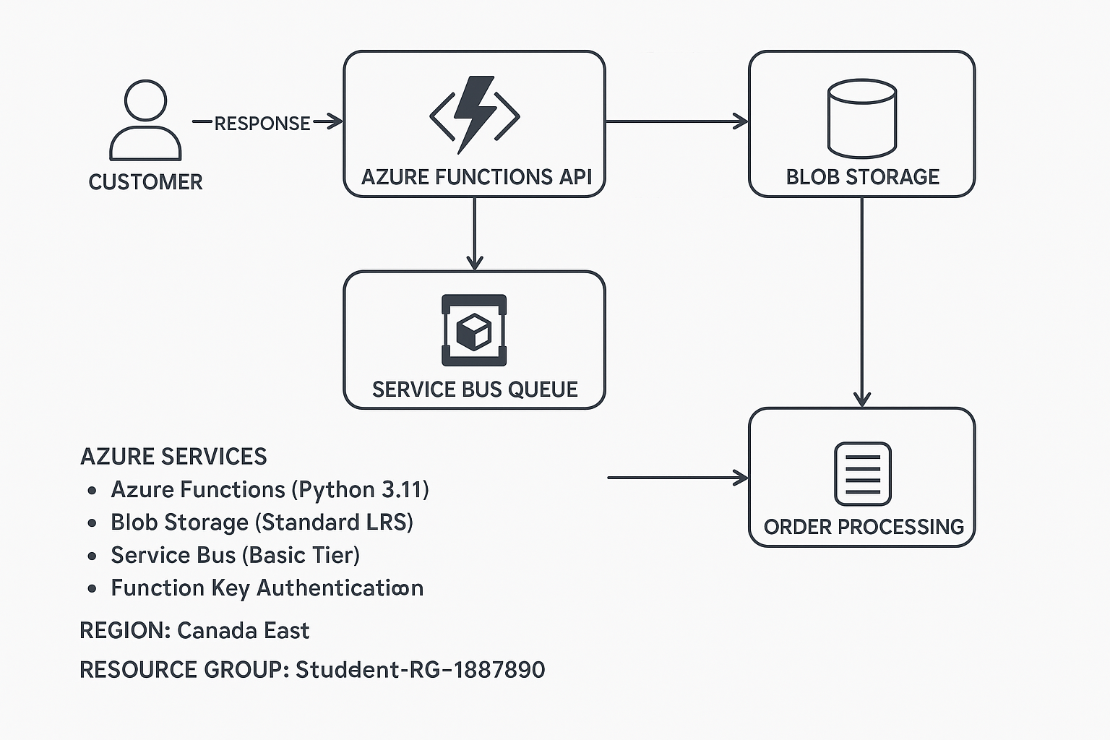
Slide 3 - ARCHITECTURE DIAGRAM

Slide 5
SLIDE 4: AZURE COMPONENTS
AZURE SERVICES USED
DEPLOYED RESOURCES:
1. ecommfunc153260237 - FUNCTION APP
Runtime: Python 3.11
3 Functions: GetProducts, CreateOrder, ProcessOrder
Status: Running
2. ecommstore153260237 - STORAGE ACCOUNT
Type: StorageV2 (Standard LRS)
Containers: products, orders
Status: Succeeded
3. ecommbus153260237 - SERVICE BUS
Tier: Basic
Queue: orders
Status: Active
ALL SERVICES OPERATIONAL IN CANADA EAST

Slide 6
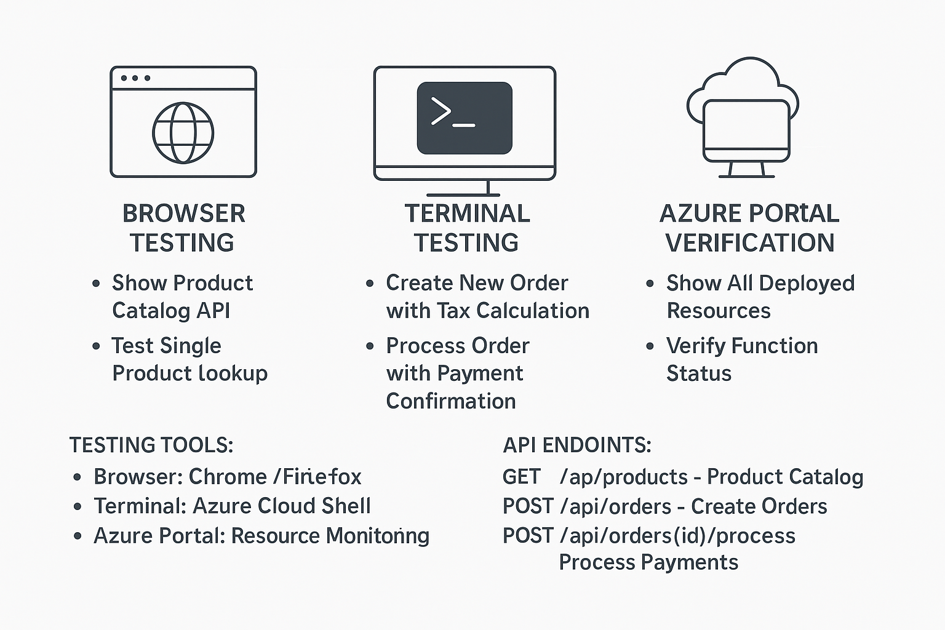
SLIDE 5: LIVE DEMO PLAN
LIVE DEMONSTRATION PLAN
DEMO SCENARIOS:

Slide 7
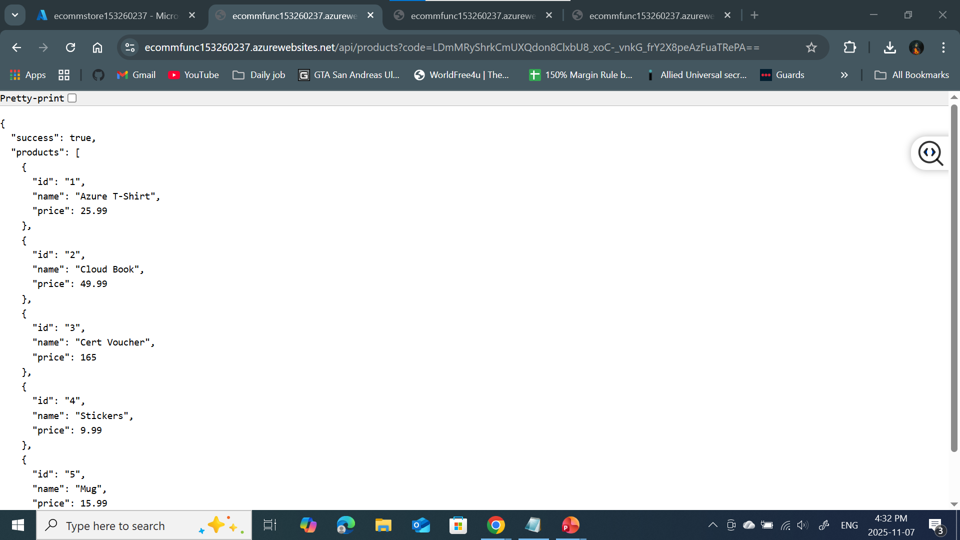
Slide 6- Browser Testing Results

Slide 8
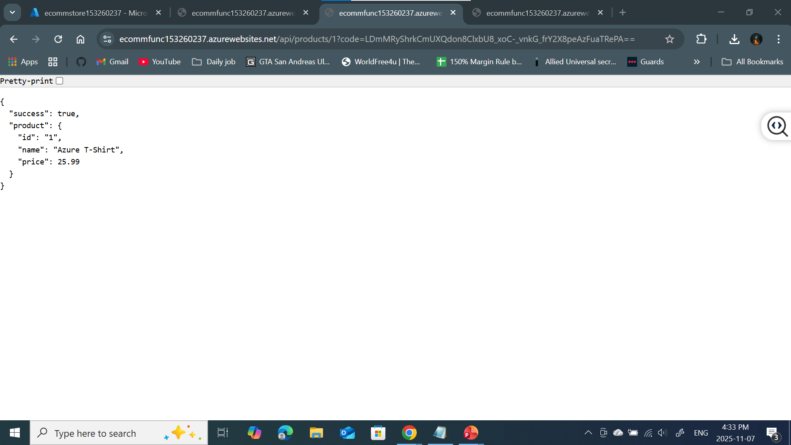
SCREENSHOT #2: Single Product Lookup

Slide 9
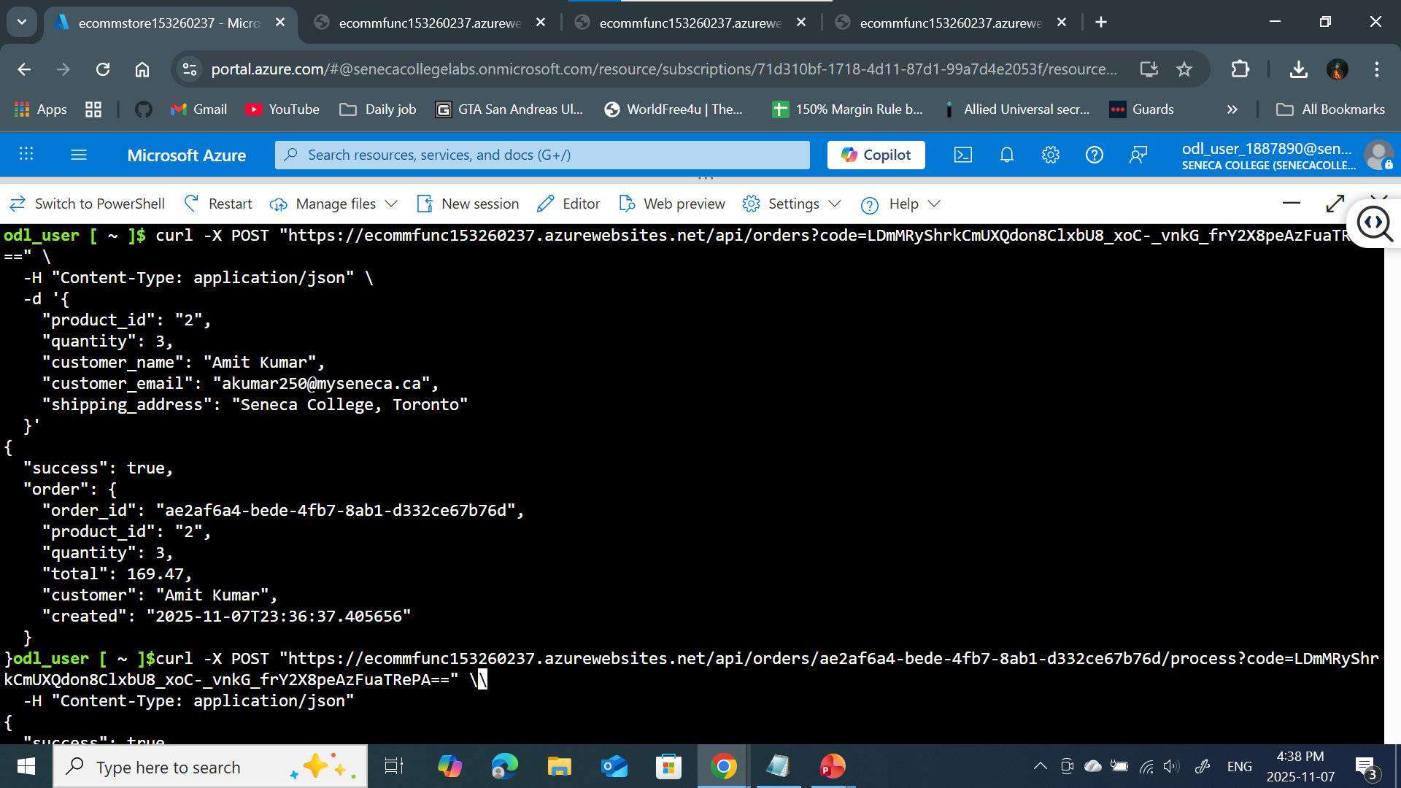
Slide 7 Terminal Testing

Slide 10
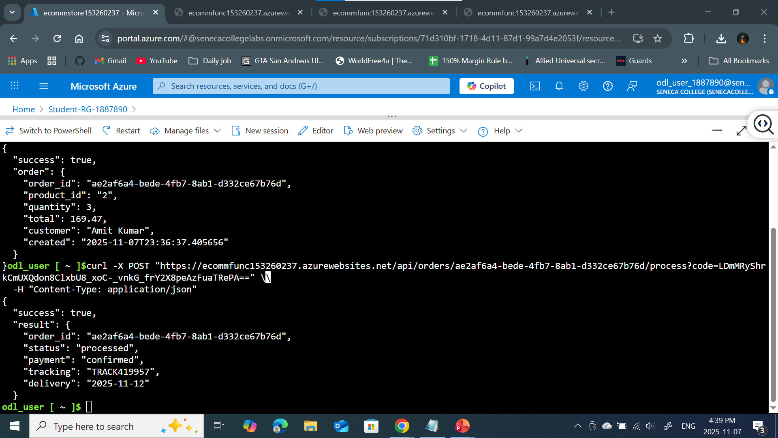
Slide 8 - Process Order terminal screenshot

Slide 11
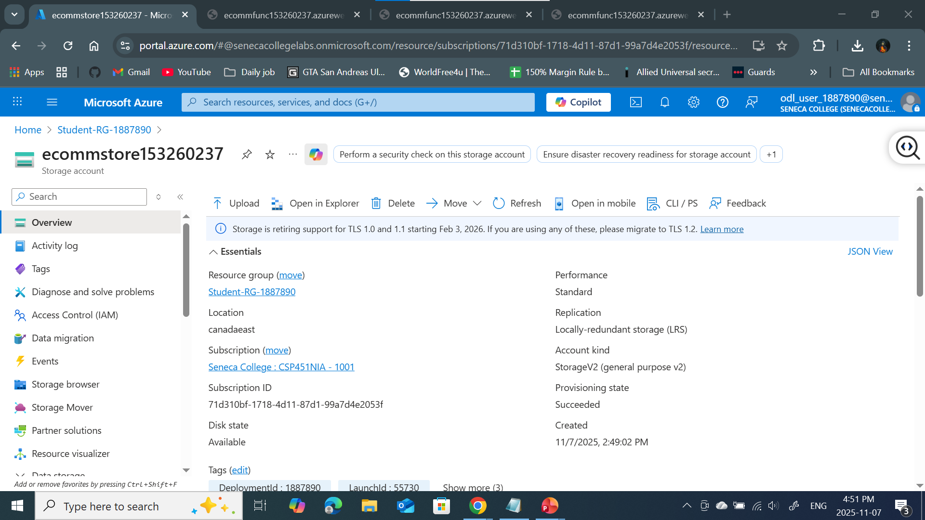
PART 3: Azure Portal (Storage Account)

Slide 12
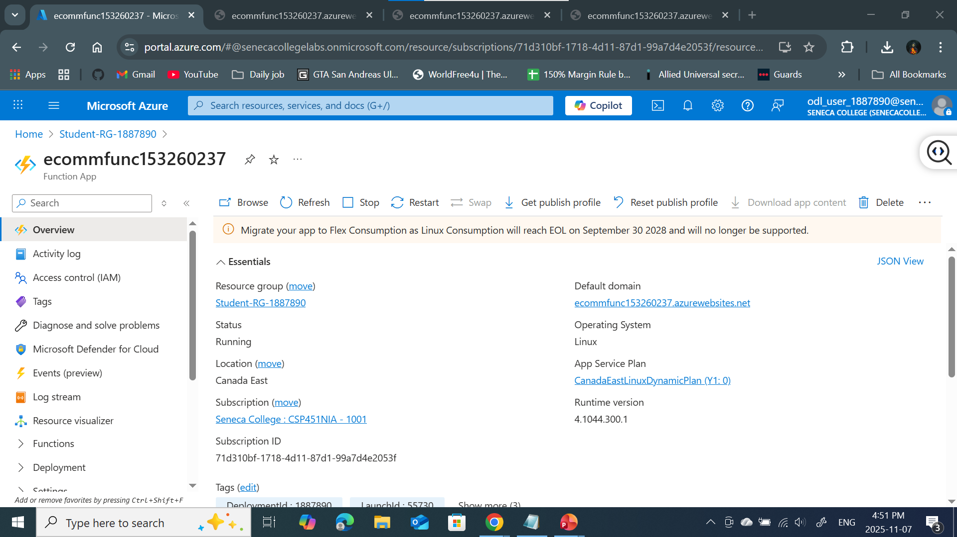
ecommfunc153260237 (Function App)

Slide 13
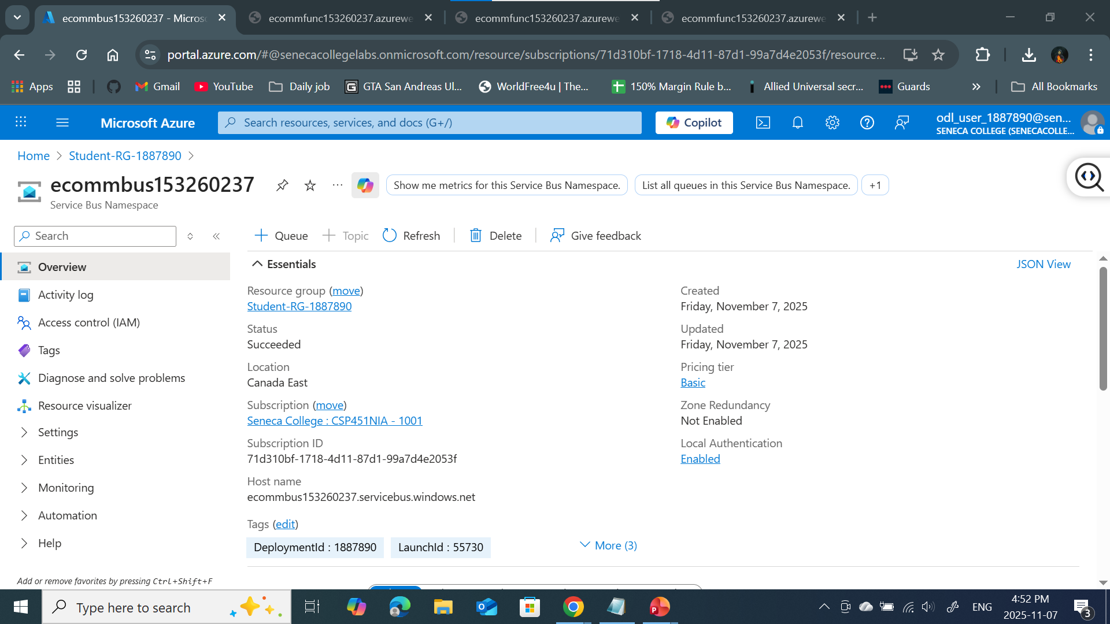
ecommbus153260237 (Service Bus)

Slide 14
SLIDE 9: BUSINESS VALUE
BUSINESS VALUE & ROI
QUANTIFIABLE BENEFITS:
95% infrastructure cost reduction
Zero server maintenance overhead
Automatic scaling during traffic spikes
99.9% uptime SLA from Microsoft
Rapid deployment (hours vs weeks)
SCALABILITY BENEFITS:
Handles 1 to 1,000,000+ requests automatically
No capacity planning required
Instant scale-up during sales events
Scale to zero when idle (zero cost)
RETURN ON INVESTMENT:
• Break-even: Immediate (no upfront costs)
• Monthly savings: $400-900 vs traditional
• Operational efficiency: 90% improvement

Slide 15
SLIDE 10: FUTURE ENHANCEMENTS
FUTURE ENHANCEMENTS
IMMEDIATE IMPROVEMENTS:
Integrate Azure Cosmos DB for global distribution
Implement Azure Logic Apps for email notifications
Add Azure API Management for rate limiting
Deploy Azure CDN for faster content delivery
ADVANCED FEATURES:
Real payment gateway integration (Stripe/PayPal)
Azure Cognitive Services for product recommendations
Application Insights for advanced monitoring
Azure Key Vault for enhanced security
Multi-region deployment for global customers

Slide 16
SLIDE 11: CHALLENGES & SOLUTIONS
CHALLENGES FACED & SOLUTIONS
TECHNICAL CHALLENGES:
Function authentication and security
JSON parsing and error handling
Azure service integration
Deployment configuration
SOLUTIONS IMPLEMENTED:
Function keys for API security
Comprehensive error handling in Python
Azure CLI for service management
Automated deployment pipelines
KEY LEARNINGS:
Serverless architecture patterns
Azure service integration best practices
Cost optimization strategies
Python development in cloud functions

Slide 17
SLIDE 12: CONCLUSION & Q&A
PROJECT SUCCESS METRICS:
3 production APIs deployed and tested
95% infrastructure cost reduction achieved
Automatic scaling implemented
Zero server management required
Enterprise-grade reliability delivered
TECHNOLOGIES DEMONSTRATED:
Azure Functions • Blob Storage
Service Bus • Python 3.11
Azure CLI • RESTful APIs
QUESTIONS & ANSWERS
Contact: Amit Kumar
Email: akumar250@myseneca.ca
Student ID: 153260237

